Slide 1

Serviworld
Your hobbies and skills, utilized

Slide 2
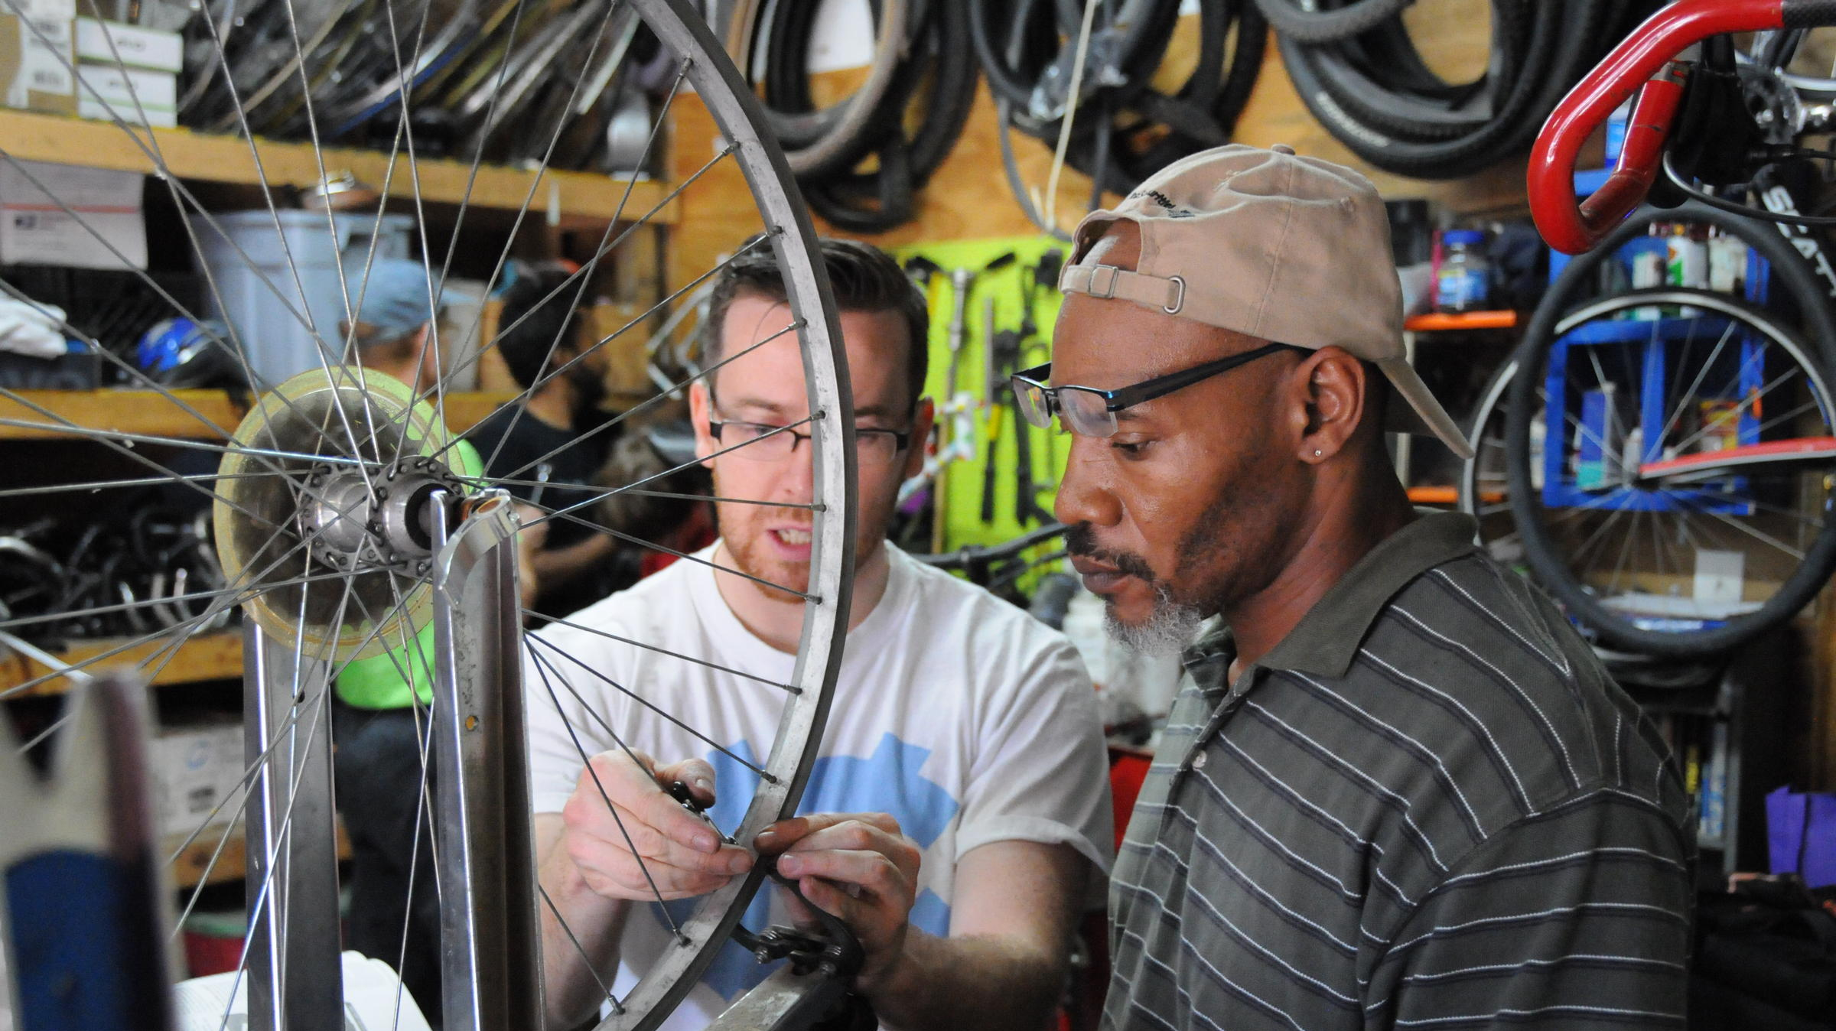
What is Serviworld?
Serviworld is a marketplace-like application where a user may post their hobbies and skills for others to request and use.

Slide 3

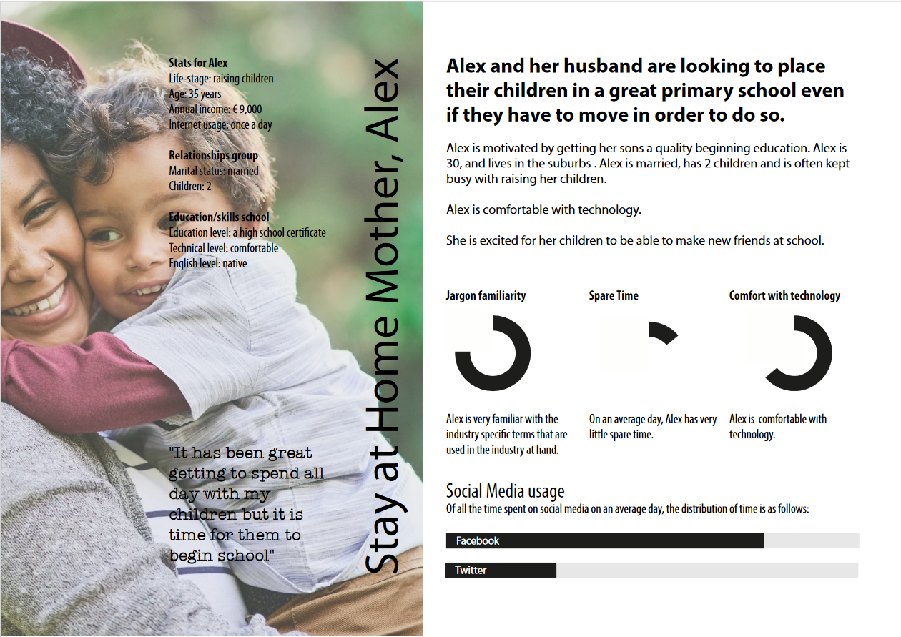
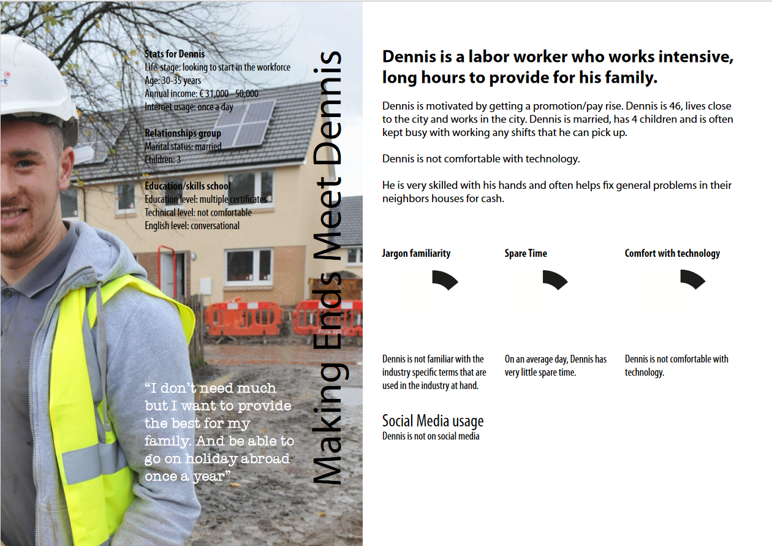
Our personas

Slide 4

How does this application help our target audiences/personas?

Slide 5
Research shows that many people like Dennis have issues with technology, and when they are busy completing favors in neighborhoods to further support their family, they face the issue of dealing with multiple messaging applications when communicating with clients. Studies show that, at least in the Netherlands, there is a variety of people with different preferences. Serviworld is made to not only ease the procedure of receiving and completing requests for a user’s service, but also advertise them.
As for people like Alex, whom most likely are not going to be submitting a service, this application will hold events to advertise trending tasks, such as fixing gardens in spring, or teaching lessons before important school exams. Alternatively, if a user can provide a service that can be done online (Software assistance, online teaching), Serviworld supports online-based services.

Slide 6

There are multiple applications like this. What makes this one different?

Slide 7

Image recognition!

Slide 8
What does it do?
To make the process of filling out information for a new service feel interesting and memorable, we use image recognition to fill out details for the user when they take a picture of their related service!

Slide 9

Demo

Slide 10

Thank you for your time!

